Slide 1
Browser Security
Part 2

Slide 2
Recap
XSS – 3 different types
  Common aim/theme
    Steal user credentials (session ID, cookies, etc.)

Slide 3
CSRF/XSRF
Cross-Site Request/Reference Forgery

Slide 4
CSRF
Cross-Site Request Forgery is an attack that forces an end user to execute unwanted actions on a web application in which they are currently authenticated.
  It inherits the identity & privileges of the victim to perform an undesired function the the victim’s behalf
CSRF attacks specifically target state-changing requests, not theft of data, since the attacker has no way to see the response to the forged request.

Slide 5
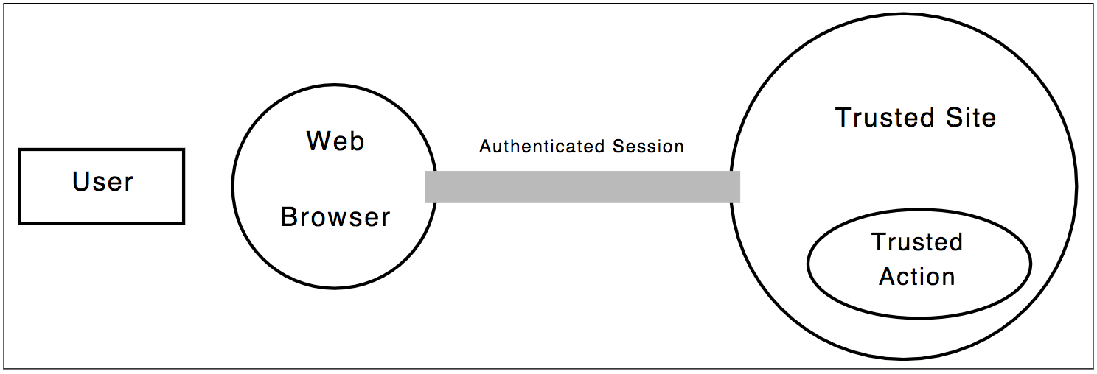
Setup
Authenticated session by an authorized user

Slide 6
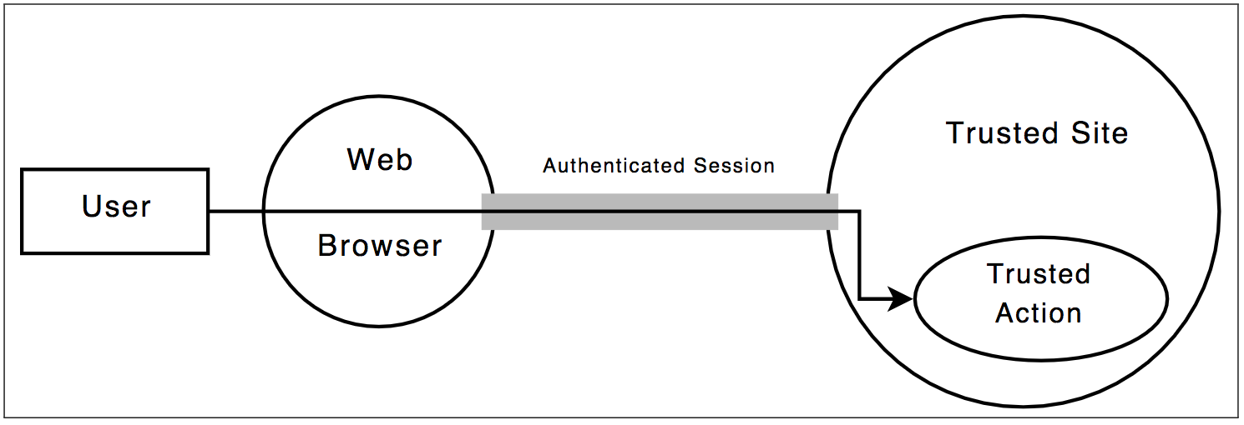
Authentication/Authorization flow
A valid request by authorized user

Slide 7
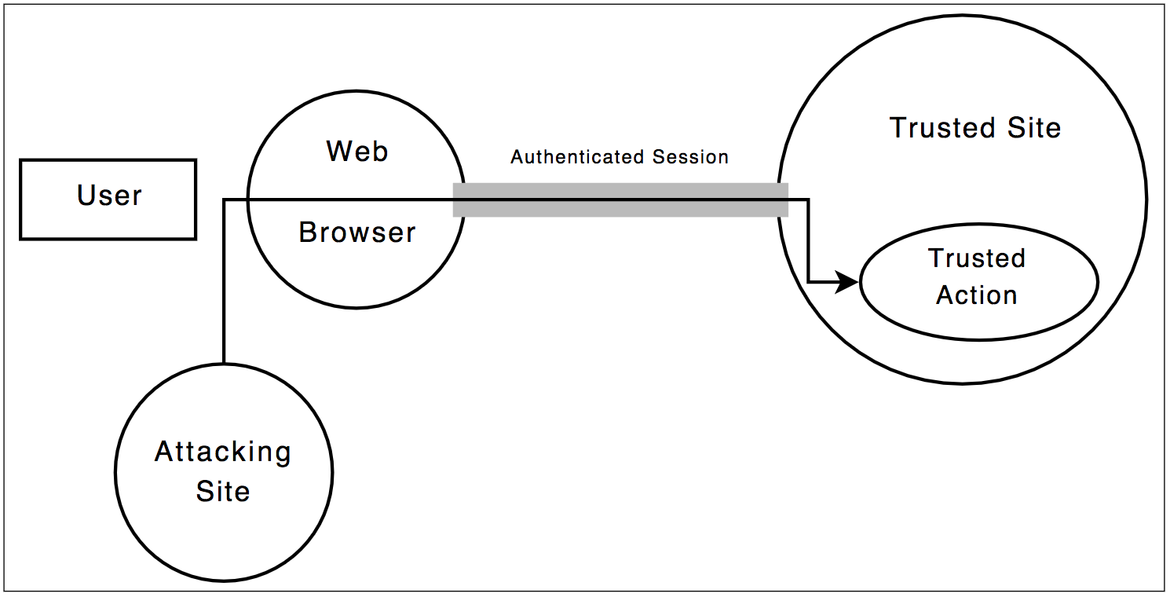
CSRF attack

Slide 8
An Example
Let’s consider a hypothetical example of a site vulnerable to a CSRF attack.
This site is a web-based email site that allows users to send and receive email.
The site uses implicit authentication to authenticate its users.
One page, http://example.com/compose.htm, contains an HTML form allowing a user to enter a recipient’s email address, subject, and message as well as a button that says, “Send Email.”

Slide 9
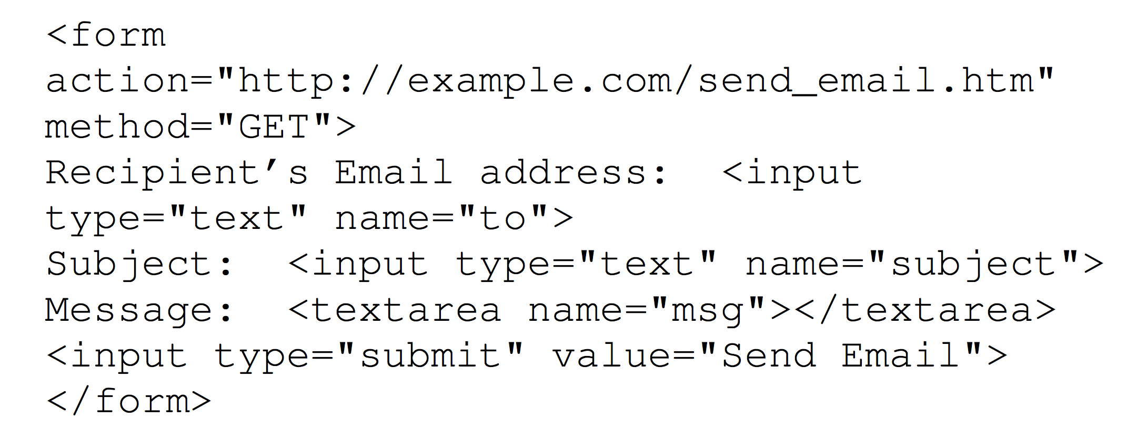

Slide 10
CSRF Example contd.
When a user of example.com clicks “Send Email”, the data he entered will be sent to http://example.com/send_email.htm as a GET request.
Since a GET request simply appends the form data to the URL, the user will be sent to the following URL (assuming he entered “bob@example.com” as the recipient, “hello” as the subject, and “What’s the status of that proposal?” as the message):

Slide 11
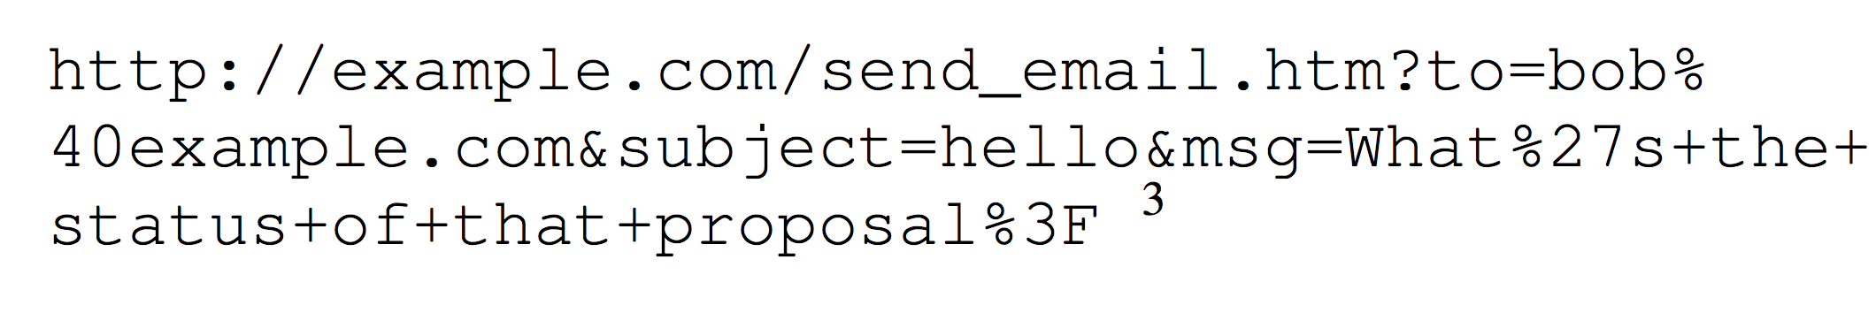

Slide 12
CSRF Example contd.
The page send_email.htm would take the data it received and send an email to the recipient from the user.
Note that send_email.htm simply takes data and performs an action with that data.
It does not care where the request originated, only that the request was made.
This means that if the user manually typed in the above URL into his browser, example.com would still send an email!

Slide 13
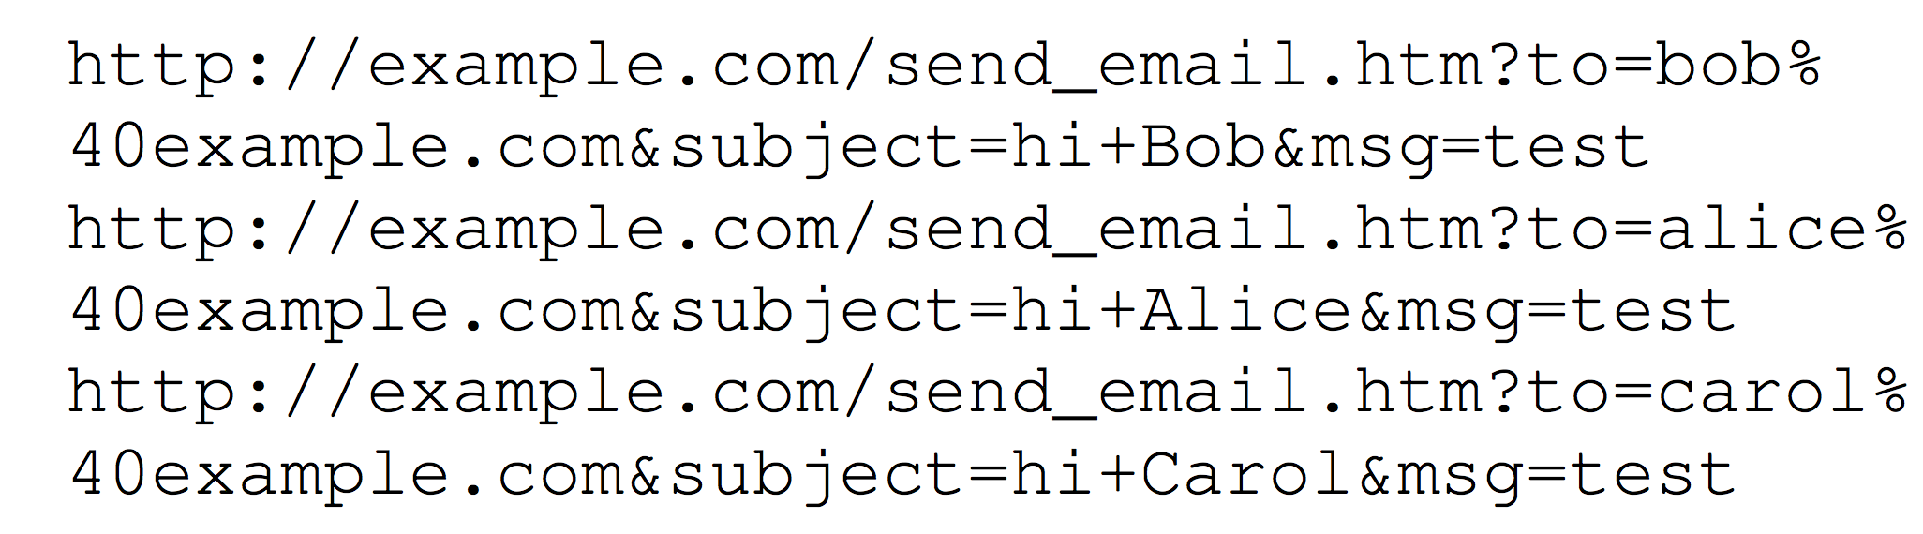

Slide 14
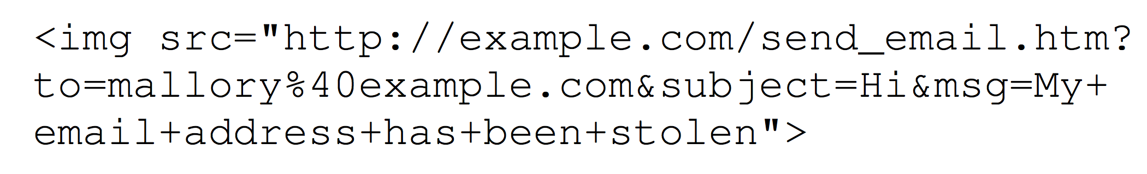
<img src=“ ”> loads whatever URI is set as the “src” attribute, even if the URI is not
an image (because the browser can only tell the URI is image after loading it

Slide 15
Authentication and CSRF
CSRF attacks often exploit the authentication mechanisms of targeted sites.
The root of the problem is that Web authentication normally assures a site that a request came from a certain user’s browser; but it does not ensure that the user actually requested or authorized the request.

Slide 16
Site Authentication Mechanism
For example, suppose that Alice visits a target site T .
T gives Alice’s browser a cookie containing a pseudorandom session identifier sid, to track her session.
Alice is asked to log in to the site, and upon entry of her valid username and password, the site records the fact that Alice is logged in to session sid.
When Alice sends a request to T, her browser automatically sends the session cookie containing sid.
T then uses its record to identify the session as coming from Alice.

Slide 17
Exploiting the authentication
Now suppose Alice visits a malicious site M.
Content supplied by M contains Javascript code or an image tag that causes Alice’s browser to send an HTTP request to T.
Because the request is going to T, Alice’s browser “helpfully” appends the session cookie sid to the request.
On seeing the request, T infers from the cookie’s presence that the request came from Alice, so T performs the requested operation on Alice’s account.
This is a successful CSRF attack.

Slide 18
In general, whenever authentication happens implicitly—there is a danger of CSRF attacks.
In principle, this danger could be eliminated by requiring the user to take an explicit, unspoofable action (such as re-entering a username and password) for each request sent to a site, but in practice this would cause major usability problems (inconvenience!)
The most standard and widely used authentication mechanisms fail to prevent CSRF attacks, so a practical solution must be sought elsewhere.

Slide 19
CSRF Attack Vectors
For an attack to be successful, the user must be logged-in to the target site and must visit the attacker’s site or a site over which the attacker has partial control.
If a server contains CSRF vulnerabilities and also accepts GET requests (as in the example shown), CSRF attacks are possible without the use of JavaScript (for example, a simple <img> tag can be used).
If the server only accepts POST requests, JavaScript is required to automatically send a POST request from the attacker’s site to the target site.

Slide 20
XSS attack (recap)
A XSS attack occurs when an attacker injects malicious code (typically JavaScript) into a site for the purpose of targeting other users of the site.
Malicious JavaScript embedded in a target site would be able to send and receive requests from any page on the site and access cookies set by that site.
Protection from XSS attacks requires sites to carefully filter any user input to ensure that no malicious code is injected.

Slide 21
CSRF vs. XSS
CSRF and XSS attacks differ in that XSS attacks require JavaScript, while CSRF attacks do not.
XSS attacks require that sites accept malicious code, while with CSRF attacks malicious code is located on third-party sites.
Filtering user input will prevent malicious code from running on a particular site, but it will not prevent malicious code from running on third-party sites.
Since malicious code can run on third-party sites, protection from XSS attacks does not protect a site from CSRF attacks.
If a site is vulnerable to XSS attacks, then it is vulnerable to CSRF attacks.
If a site is completely protected from XSS attacks, it is most likely still vulnerable to CSRF attacks.

Slide 22
Preventing CSRF
Allow GET requests to only retrieve data, not modify any data on the server
Require all POST requests to include a pseudorandom value
Use a pseudorandom value that is independent of a user’s account

Slide 23
CSRF Defense
Check standard headers to verify the request is same origin, and
Check CSRF token

Slide 24
SOP (Same Origin Policy)
Determine the origin the request is coming from (source origin)
Determine the origin the request is going to (target origin)
Referer header
Origin header
Notes:
if your site is "site.com" make sure "site.com.attacker.com" doesn't pass your origin check (i.e., match through the trailing / after the origin to make sure you are matching against the entire origin).

Slide 25
CSRF Tokens
Synchronizer (CSRF) Tokens
Double cookie defense
Encrypted token pattern
Custom Header
  E.g., X-Requested-With: XMLHttpRequest

Slide 26
Synchronizer Token
Any state changing operation requires CSRF token
Characteristics of CSRF token:
  Unique per user session
  Large random value
  Generated by cryptographically secure RNG
The CSRF token is added as a hidden field
The server rejects the requested action if token validation fails

Slide 27
Alternate CSRF Defenses
Re-authentication
OTP
CAPTCHA

Slide 28
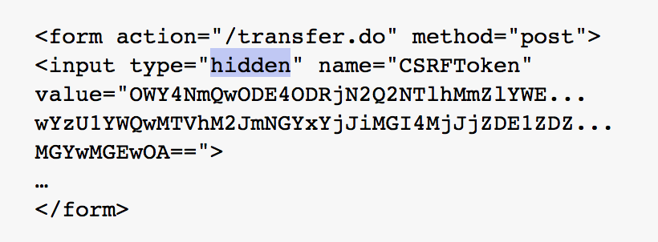
Example

Slide 29
Reference
Cross-Site Request Forgeries: Exploitation and Prevention
  http://www.cs.utexas.edu/~shmat/courses/cs378_spring09/zeller.pdf
Robust defenses for Cross-site Request Forgery
https://seclab.stanford.edu/websec/csrf/csrf.pdf
RequestRodeo: Client Side Protection against Session Riding
https://www.owasp.org/images/4/42/RequestRodeo-MartinJohns.pdf

Slide 30
Curiosity Exercise
ClickJacking
LikeJacking
XSHM

Slide 31
Exercises
What are Cookies?
Browser cache & Browser fingerprint
Session ID
GET vs POST methods
HTTP is a stateless protocol, why is it called stateless?
HTTP Request Header values
XMLHttpRequest
Forbidden Headers list (what is their purpose)
X-Forwarded-Host header
Is HTTPS a stateful protocol?
Try Burpe Suite or Arachni or OWASP ZAP

